Slide 1

Web Programming
CS-406
Lecture # 09
PHP State Information Variables

Slide 2

Understanding State Information
Information about individual visits to a Web site is called state information
HTTP was originally designed to be stateless – Web browsers store no persistent data about a visit to a Web site
Maintaining state means to store persistent information about Web site visits with hidden form fields, query strings, cookies, and sessions

Slide 3
Understanding State Information (continued)
Customize individual Web pages based on user preferences
Temporarily store information for a user as a browser navigates within a multipart form
Allow a user to return to specific locations within a Web site
Provide shopping carts that store order information

Slide 4
Understanding State Information (continued)
Store user IDs and passwords
Use counters to keep track of how many times a user has visited a site
The four tools for maintaining state information with PHP are:
Hidden form fields
Query strings
Cookies
Sessions

Slide 5
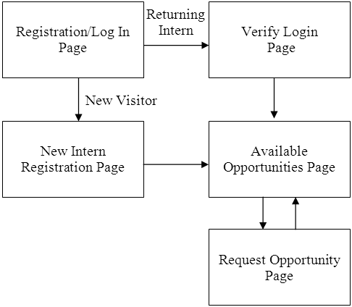

Slide 6
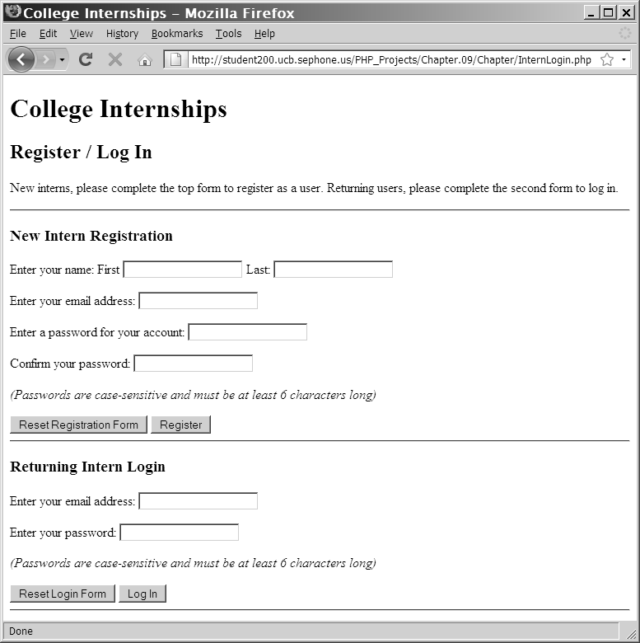
Understanding State Information (continued)

Slide 7
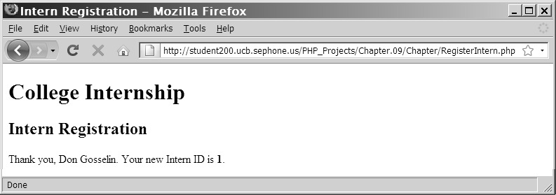
Understanding State Information (continued)

Slide 8
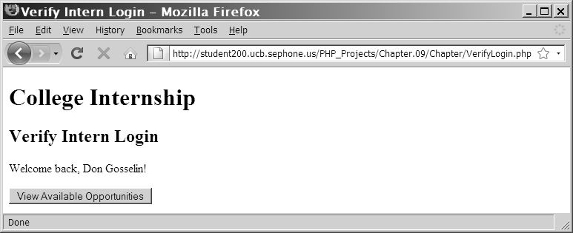
Understanding State Information (continued)

Slide 9
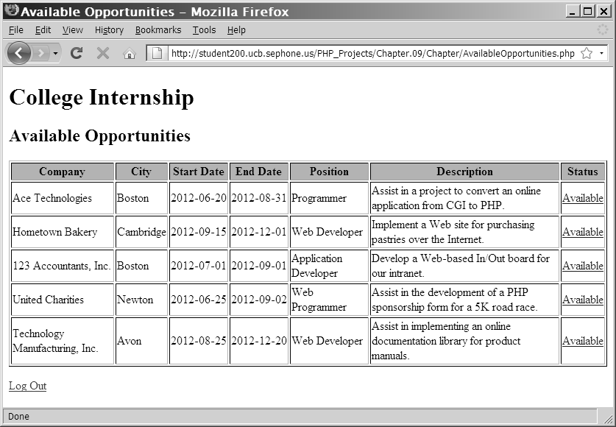
Understanding State Information (continued)

Slide 10
Using Hidden Form Fields to Save State Information
Create hidden form fields with the <input> element
Hidden form fields temporarily store data that needs to be sent to a server that a user does not need to see
Examples include the result of a calculation
The syntax for creating hidden form fields is:
<input type="hidden">

Slide 11
Using Hidden Form Fields to Save State Information (continued)
Hidden form field attributes are name and value
When submitting a form to a PHP script, access the values submitted from the form with the $_GET[] and $_POST[] autoglobals
To pass form values from one PHP script to another PHP script, store the values in hidden form fields

Slide 12

Using Hidden Form Fields to Save State Information (continued)
echo "<form method='post' " .
" action='AvailableOpportunities.php'>\n";
echo "<input type='hidden' name='internID' " .
" value='$InternID'>\n";
echo "<input type='submit' name='submit' " .
" value='View Available Opportunities'>\n";
echo "</form>\n";

Slide 13

Using Query Strings to Save State Information
A query string is a set of name=value pairs appended to a target URL
Consists of a single text string containing one or more pieces of information
Add a question mark (?) immediately after the URL followed by the query string that contains the information you want to preserve in name/value pairs

Slide 14
Using Query Strings to Save State Information (continued)
Separate individual name=value pairs within the query string using ampersands (&)
A question mark (?) and a query string are automatically appended to the URL of a server-side script for any forms that are submitted with the GET method
<a href="http://www.example.com/TargetPage .php?firstName=Don&lastName=Gosselin& occupation=writer">Link Text</a>

Slide 15
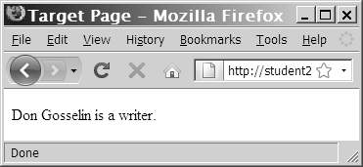
Using Query Strings to Save State Information (continued)
echo "{$_GET['firstName']} {$_GET['lastName']}
is a {$_GET['occupation']}. ";

Slide 16
Using Cookies to Save State Information
Query strings do not permanently maintain state information
After a Web page that reads a query string closes, the query string is lost
To store state information beyond the current Web page session, Netscape created cookies
Cookies, or magic cookies, are small pieces of information about a user that are stored by a Web server in text files on the user’s computer

Slide 17
Using Cookies to Save State Information (continued)
Temporary cookies remain available only for the current browser session
Persistent cookies remain available beyond the current browser session and are stored in a text file on a client computer
Each individual server or domain can store between 20 and 70 cookies on a user’s computer
Total cookies per browser cannot exceed 300
The largest cookie size is 4 kilobytes

Slide 18
Creating Cookies
The syntax for the setcookie() function is:
setcookie(name [,value ,expires, path, domain, secure])
You must pass each of the arguments in the order specified in the syntax
To skip the value, path, and domain arguments, specify an empty string as the argument value
To skip the expires and secure arguments, specify 0 as the argument value

Slide 19
Creating Cookies (continued)
Call the setcookie() function before sending the Web browser any output, including white space, HTML elements, or output from the echo() or print() statements
Users can choose whether to accept cookies that a script attempts to write to their system
A value of TRUE is returned even if a user rejects the cookie

Slide 20
The name and value Arguments
Cookies created with only the name and value arguments of the setcookie() function are temporary cookies because they are available for only the current browser session
<?php
setcookie("firstName", "Don");
?>
<!DOCTYPE html PUBLIC "-//W3C//DTD XHTML 1.0 Strict//EN"
"http://www.w3.org/TR/xhtml1/DTD/xhtml1-strict.dtd">
<html xmlns="http://www.w3.org/1999/xhtml">
<head>
<title>College Internships</title>
...

Slide 21
The name and value Arguments (continued)
The setcookie() function can be called multiple times to create additional cookies – as long as the setcookie() statements come before any other output on a Web page
setcookie("firstName", "Don");
setcookie("lastName", "Gosselin");
setcookie("occupation", "writer");

Slide 22
The name and value Arguments (continued)
The following code creates an associative cookie array named professional[] that contains three cookie values:
setcookie("professional['firstName']", "Don");
setcookie("professional['lastName']", "Gosselin");
setcookie("professional['occupation']", "writer");

Slide 23
The expires Argument
The expires argument determines how long a cookie can remain on a client system before it is deleted
Cookies created without an expires argument are available for only the current browser session
To specify a cookie’s expiration time, use PHP’s time() function
setcookie("firstName", "Don", time()+3600);

Slide 24

The path Argument
The path argument determines the availability of a cookie to other Web pages on a server
Using the path argument allows cookies to be shared across a server
A cookie is available to all Web pages in a specified path as well as all subdirectories in the specified path
setcookie("firstName", "Don", time()+3600, "/marketing/");

Slide 25

The domain Argument
The domain argument is used for sharing cookies across multiple servers in the same domain
Cookies cannot be shared outside of a domain
setcookie("firstName", "Don”, time()+3600, "/", ".gosselin.com");

Slide 26
The secure Argument
The secure argument indicates that a cookie can only be transmitted across a secure Internet connection using HTTPS or another security protocol
To use this argument, assign a value of 1 (for TRUE) or 0 (for FALSE) as the last argument of the setcookie() function
setcookie("firstName”, "Don", time()+3600, "/", ".gosselin.com", 1);

Slide 27
Reading Cookies
Cookies that are available to the current Web page are automatically assigned to the $_COOKIE autoglobal
Access each cookie by using the cookie name as a key in the associative $_COOKIE[] array
echo $_COOKIE['firstName'];
Newly created cookies are not available until after the current Web page is reloaded

Slide 28
Reading Cookies (continued)
To ensure that a cookie is set before you attempt to use it, use the isset() function
setcookie("firstName", "Don");
setcookie("lastName", "Gosselin");
setcookie("occupation", "writer");
if (isset($_COOKIE['firstName'])
&& isset($_COOKIE['lastName'])
&& isset($_COOKIE['occupation']))
echo "{$_COOKIE['firstName']} {$_COOKIE['lastName']}
is a {$_COOKIE['occupation']}.";

Slide 29
Reading Cookies (continued)
Use multidimensional array syntax to read each cookie value
setcookie("professional[0]", "Don");
setcookie("professional[1]", "Gosselin");
setcookie("professional[2]", "writer");
if (isset($_COOKIE['professional']))
echo "{$_COOKIE['professional'][0]}
{$_COOKIE['professional'][1]} is a
{$_COOKIE['professional'][2]}.";

Slide 30
Deleting Cookies
To delete a persistent cookie before the time assigned to the expires argument elapses, assign a new expiration value that is sometime in the past
Do this by subtracting any number of seconds from the time() function
setcookie("firstName", "", time()-3600);
setcookie("lastName", "", time()-3600);
setcookie("occupation", "", time()-3600);

Slide 31
Using Sessions to Save State Information
Spyware gathers user information from a local computer for marketing and advertising purposes without the user’s knowledge
A session refers to a period of activity when a PHP script stores state information on a Web server
Sessions allow you to maintain state information even when clients disable cookies in their Web browsers

Slide 32
Starting a Session
The session_start() function starts a new session or continues an existing one
The session_start() function generates a unique session ID to identify the session
A session ID is a random alphanumeric string that looks something like: 7f39d7dd020773f115d753c71290e11f
The session_start() function creates a text file on the Web server that is the same name as the session ID, preceded by sess_

Slide 33
Starting a Session (continued)
Session ID text files are stored in the Web server directory specified by the session.save_path directive in your php.ini configuration file
The session_start() function does not accept any arguments, nor does it return a value that you can use in your script
<?php
session_start();
...

Slide 34
Starting a Session (continued)
You must call the session_start() function before you send the Web browser any output
If a client’s Web browser is configured to accept cookies, the session ID is assigned to a temporary cookie named PHPSESSID
Pass the session ID as a query string or hidden form field to any Web pages that are called as part of the current session

Slide 35
Starting a Session (continued)
<?php
session_start();
...
?>
<p><a href='<?php echo "Occupation.php?PHPSESSID="
. session_id() ?>'>Occupation</a></p>

Slide 36
Working with Session Variables
Session state information is stored in the $_SESSION autoglobal
When the session_start() function is called, PHP either initializes a new $_SESSION autoglobal or retrieves any variables for the current session (based on the session ID) into the $_SESSION autoglobal

Slide 37
Working with Session Variables (continued)
<?php
session_start();
$_SESSION['firstName'] = "Don";
$_SESSION['lastName'] = "Gosselin";
$_SESSION['occupation'] = "writer";
?>
<p><a href='<?php echo "Occupation.php?"
. session_id() ?>'>Occupation</a></p>

Slide 38

Working with Session Variables (continued)
Use the isset() function to ensure that a session variable is set before you attempt to use it
<?php
session_start();
if (isset($_SESSION['firstName']) && isset($_SESSION['lastName'])
&& isset($_SESSION['occupation']))
echo "<p>" . $_SESSION['firstName'] . " "
. $_SESSION['lastName'] . " is a "
. $_SESSION['occupation'] . "</p>";
?>

Slide 39
Deleting a Session
To delete a session manually, perform the following steps:
1. Execute the session_start() function
2. Use the array() construct to reinitialize the $_SESSION autoglobal
3. Use the session_destroy() function to delete the session

Slide 40
Deleting a Session (continued)
<?php
session_start();
$_SESSION = array();
session_destroy();
?>

